Slide 1
Chapter 3: Genetic variation

Slide 2
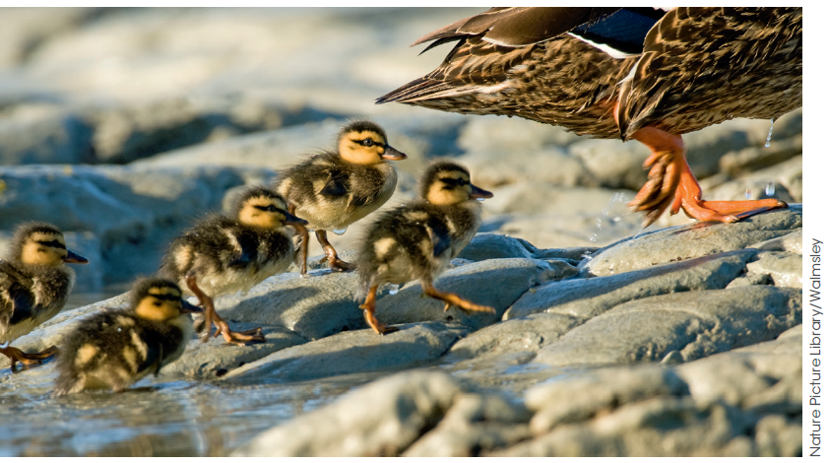
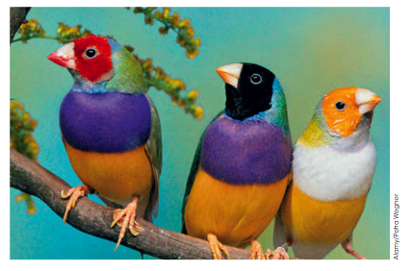
Variation
Figure 3.1
Figure 3.2
While variation between species allows us to tell them apart, variation is a common and important observation within species.
This is intraspecific variation.
Variation in phenotypes can be genetically, or epigenetically, determined.

Slide 3
Variation
Different types of phenotypic variation
Table 3.1
Type of variation | Describes variation in… | Example
Morphological | Shape and structure including internal anatomy | Bird’s size and shape
Biochemical | Chemical structure and composition of organisms including proteins, lipids, carbohydrates, and other molecules | Expression of enzymes creating pigments and resulting colour of head feathers
Physiological | Metabolic and other bodily processes | Starvation stress; control of egg production
Behavioural | The ways individuals perceive, think, and react Includes cognition and behaviour. | Aggression; inquisitiveness; mate selection

Slide 4
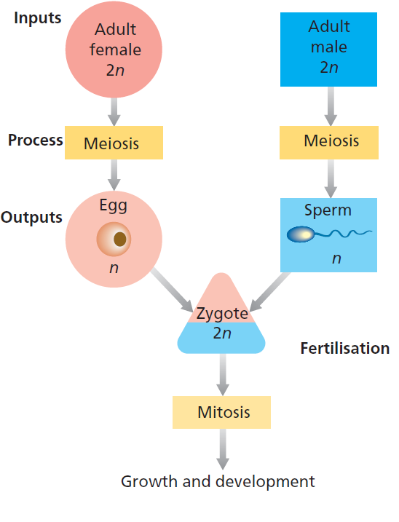
Variation
Sexual reproduction is a key biological source of variation
Crossing over – recombination of chromosomal sections in prophase I
Random assortment of chromosomes into gametes
Random fusion of gametes at fertilisation
But these processes do not account
for new variation.
Figure 1.29 (Chapter 1: DNA)

Slide 5
Mutation is the source of new variation
Mutation
Physical
mutagens
Mutation in somatic cell
All daughter cells affected
Chemical
mutagens
Mutation:
change in DNA
Mutation in germline cell
Offspring
affected
Biological
mutagens

Slide 6
Mutation is the source of new variation
Mutation
Physical
mutagens
No effect
Chemical
mutagens
Mutation:
change in DNA
Harmful
effect
Impairs
protein function
Beneficial
effect
Enhances protein function
Biological
mutagens
Many cellular processes exist to repair mutations in DNA because:
harmful mutations can stop a protein, and therefore a cell, from functioning properly
harmful mutations may impair the process of apoptosis, leading to cancer.
If a cell cannot repair a mutation it will try to undergo apoptosis.

Slide 7
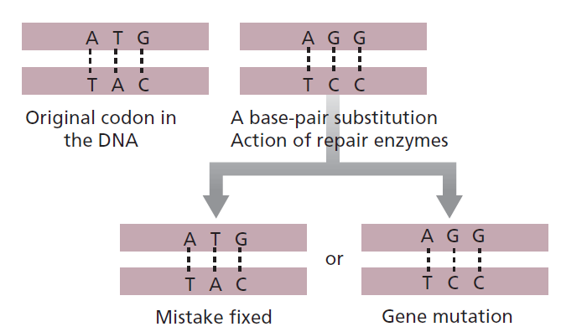
Errors in cell division
Agents of mutation
When the DNA is exposed (e.g. during S phase for replication), some bases can be modified to resemble others.
During replication the wrong complimentary base may be substituted as a result.
Figure 3.4
Whether the DNA repair machinery detects this mutation in time will determine whether the mistake is corrected or passed to daughter cells.

Slide 8
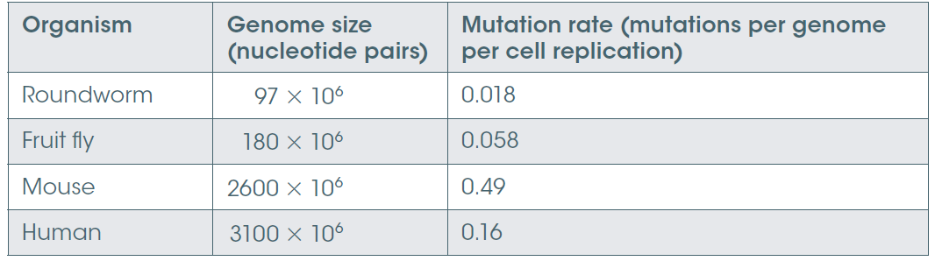
Errors in cell division
Agents of mutation
This process of base pair substitution forms a natural spontaneous mutation rate, which differs between organisms.
Table 3.2
Mutation rates show that mutations rarely persist – due to efficient repair mechanisms.
Mutations also arise randomly throughout the genome –
their locations are not directed.

Slide 9
Physical mutagens
Agents of mutation
Different physical mutagens have different effects. Some examples:
UV light
Fuses adjacent thymines or cytosines to distort DNA
X-rays
Cause the loss of adenine and guanine bases leaving gaps in the DNA
Nuclear radiation
Causes double-stranded breaks in DNA.
Repair mechanisms may fuse the wrong DNA sections together

Slide 10
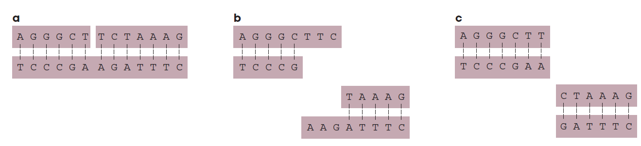
Physical mutagens
Agents of mutation
Figure 3.5
Original sequence
Overhanging single-stranded segments give some direction about how to repair the lesion.
Lesions with ‘blunt’ ends give much less information about how to repair and can lead to more major DNA changes.

Slide 11
Chemical mutagens
Agents of mutation
Chemical mutagens can:
add or remove bases
change one base to another
cross-link bases to distort the DNA shape and affect replication
insert between the bases to distort the DNA
look like a nucleotide and be incorporated into DNA during replication, but affect the accuracy of subsequent replication
cause major changes in chromosomal structure.

Slide 12
Biological agents
Agents of mutation
Pathogens can insert their DNA into a host’s genome so they can get a ‘free ride’.
Examples include the Ti plasmid of Agrobacterium which infects plants, and the human papilloma virus (HPV).
This is called horizontal gene transfer.
Where this DNA is inserted it may disrupt a gene, causing a mutation.

Slide 13
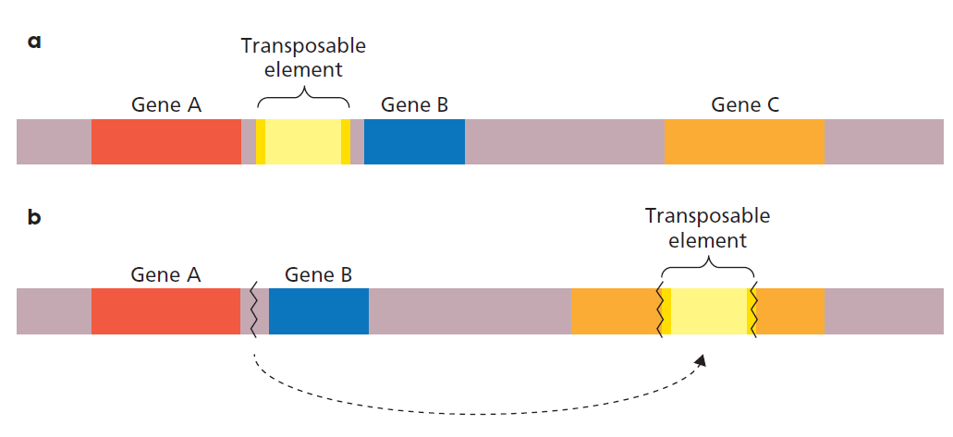
Biological agents
Agents of mutation
Another example of a possible biological mutagen is a transposon, or transposable element.
Figure 3.7
These are believed to have evolved from viruses and, over the course of evolution, have significantly changed the genomes of most species. Much of our DNA comprises inactive transposable elements.
A transposon that affects the X chromosome is thought to be responsible for causing haemophilia.

Slide 14
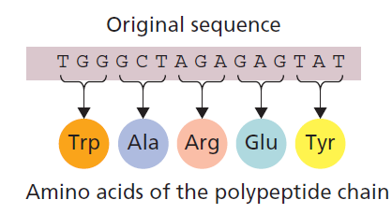
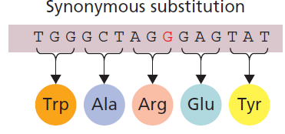
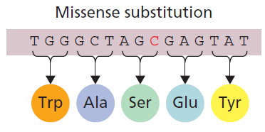
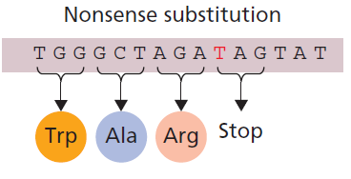
Point mutation, or substitution
Types of mutation
Sequence differences between individuals at a single position are called single nucleotide polymorphisms (SNPs; ‘snips’).
Doesn’t alter the amino acid sequence.
This is because of redundancy in the genetic code (several codons → each amino acid)
Changes the amino acid sequence
Introduces a stop codon, truncating the protein
Figure 3.11

Slide 15
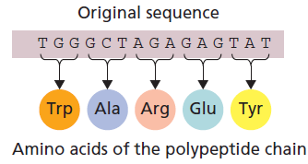
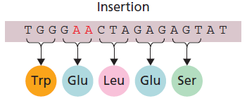
Insertions and deletions (indels)
Types of mutation
Figure 3.11
A section of DNA (any length) is inserted.
Deletion
A section of DNA (any length) is deleted.
A potential significant effect of indels is the introduction of a frameshift mutation, affecting all downstream codons in the gene.

Slide 16
Effects of mutations on survival
Types of mutation
Neutral
Does not change the amino acid, or changes it to on with a similar shape and charge. Protein essentially unchanged.
Deleterious
Deletes, impairs or enhances the protein’s activity in such a way that the organism is adversely affected. Can lead to premature death of the organism.
Beneficial
Changes the protein’s activity in such a way that the organism benefits.
Mutations occur throughout the genome and non-coding regions are also affected.
Can you predict some effects of each of these types of mutations if they occur in non-coding DNA?

Slide 17
Changes to chromosomes
Chromosomal variations
While point mutations, insertions and deletions may only affect a small locus within a chromosome, variations to chromosomes may occur on larger scales.
Whole chromosomes, or sections of chromosomes, may be duplicated or deleted.
Chromosomal variations can affect many more genes than point mutations.

Slide 18
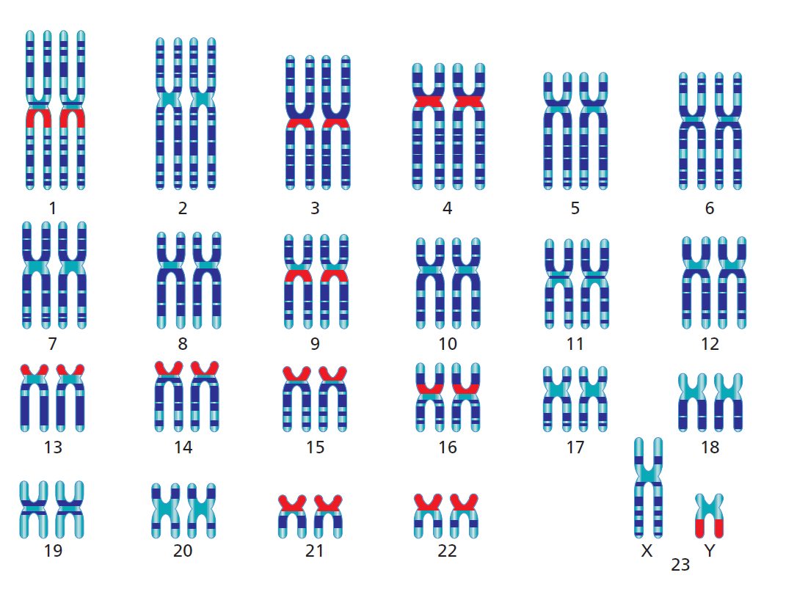
Karyotype
Chromosomal variations
A karyotype is a visual representation of chromosomes in an individual, photographed in a cell during metaphase.
Can be diagnostic, most obviously of the sex of the individual.

Slide 19
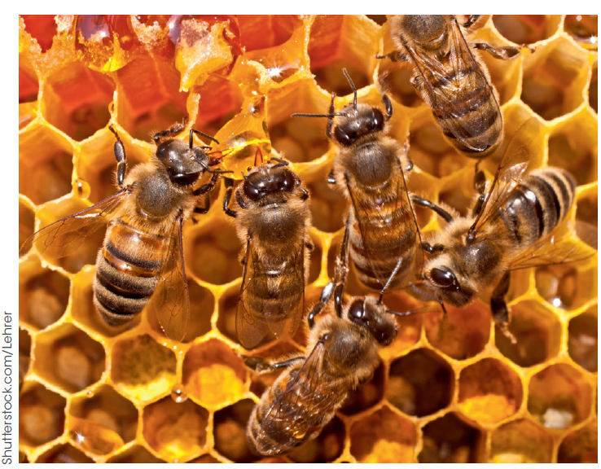
Variations in chromosome number
Chromosomal variations
Many eukaryotes are diploid (2n) and their gametes are haploid (n).
Some organisms, such as male bees, are monoploid (n).
They are not said to be haploid because in this case, n provides a complete and operational set of genes.
Females
Males
Meiosis
Mitosis
Eggs
Sperm
Parthenogenesis
Sexual
reproduction
Male
offspring
Female
offspring
Figure 3.15

Slide 20
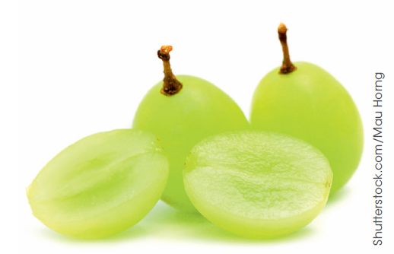
Polyploidy
Chromosomal variations
Polyploidy occurs when cell divisions fail during gamete formation, producing 2n gametes.
When these fuse with haploid gametes, 3n zygotes are formed.
Two sets of 2n gametes may fuse to form 4n offspring.
Acquiring an additional set of chromosomes is call polyploidy and, in some organsisms such as flowering plants, may confer advantageous features.
Figure 3.16

Slide 21
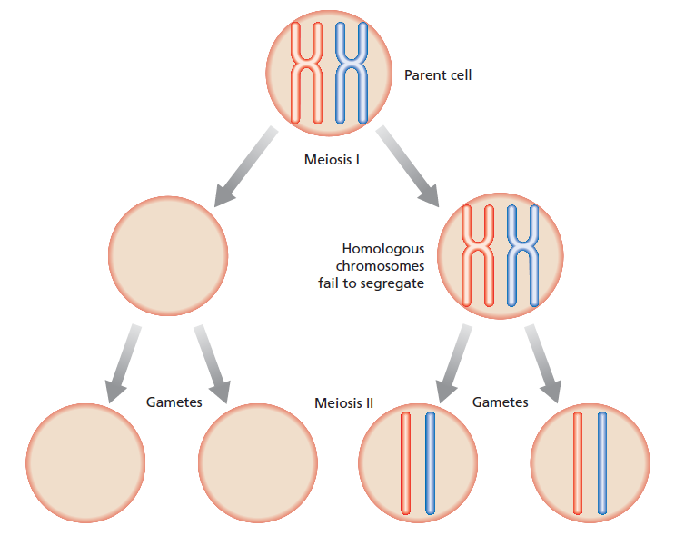
Aneuploidy
Chromosomal variations
Aneuploidy involves the addition or loss of a single chromosome.
Aneuploidy occurs via
non-disjunction, the failure of separation of homologous chromosomes during meiosis.
Aneuploidy is often lethal to the zygote, causing miscarriages.
Figure 3.17

Slide 22
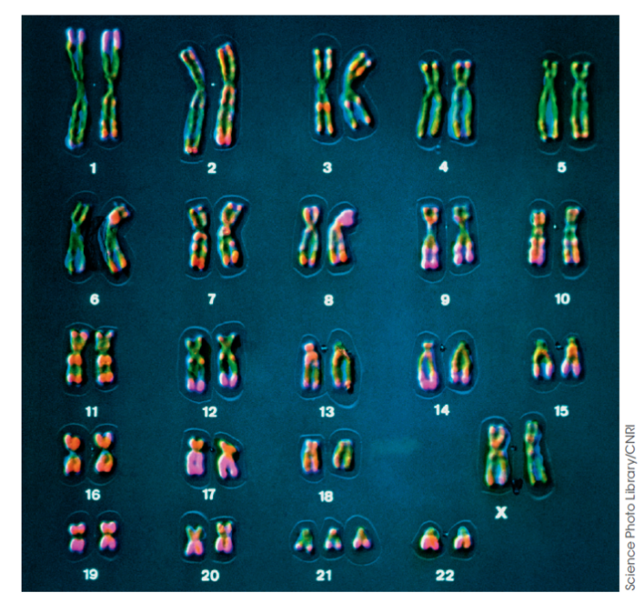
Aneuploidy
Chromosomal variations
Non-disjunction can produce a gamete missing a chromosome and a gamete with two copies.
Fertilisation of a gamete with two copies of a chromosome can produce a zygote with three copies of the chromosome. This situation is called trisomy.
Trisomy 21 (three copies of chromosome 21) is the cause of Down syndrome.
Figure 3.18

Slide 23
Aneuploidy
Chromosomal variations
Non-disjunction of sex chromosomes can cause various phenotypes in humans.
Karyotype | Syndrome | Phenotype | Frequency
XXY | Klinefelter syndrome | Phenotypically men, infertile, small genitals. May develop breasts | 1:500-1:1000 per live male births
XO (O denotes absence) | Turner syndrome | Phenotypically females, infertile, characteristically webbed neck | 1:2500 per live female births

Slide 24
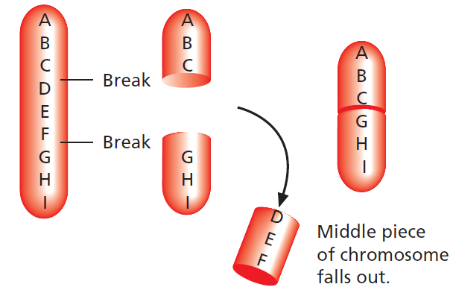
Variations in chromosome structure
Chromosomal variations
Deletion
This is usually fatal or associated with adverse effects.
Figure 3.19a

Slide 25
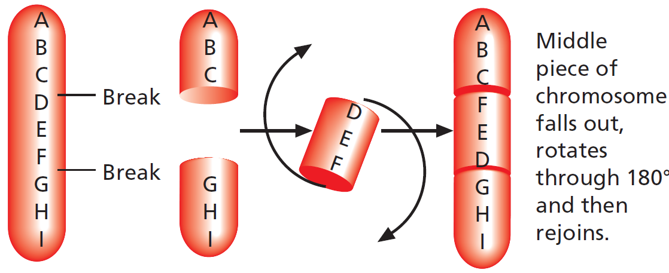
Variations in chromosome structure
Chromosomal variations
Inversion
Effects are usually mild since genes are neither added nor lost.
Figure 3.19b

Slide 26
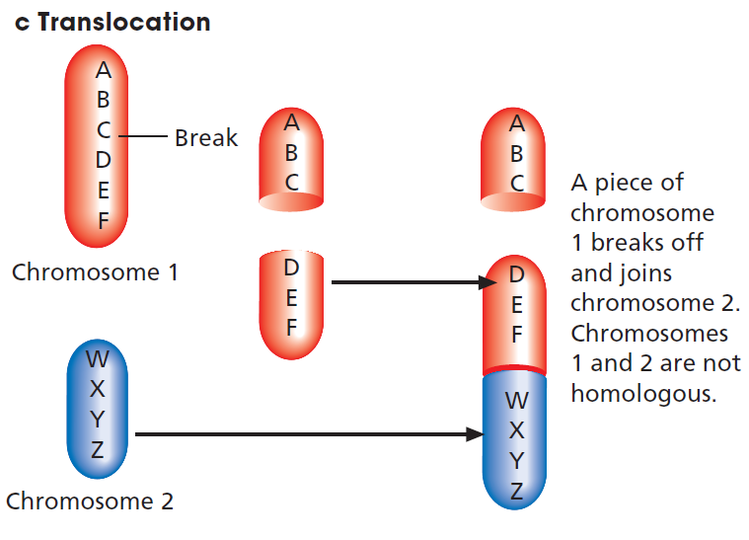
Variations in chromosome structure
Chromosomal variations
Translocation
This changes regulation of genes by moving them to different regions.
Causative mutation in several cancers
Figure 3.19c

Slide 27
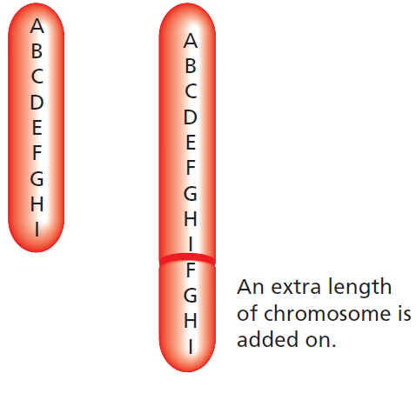
Variations in chromosome structure
Chromosomal variations
Duplication
This is usually harmful but may be beneficial.
Figure 3.19d

Slide 28
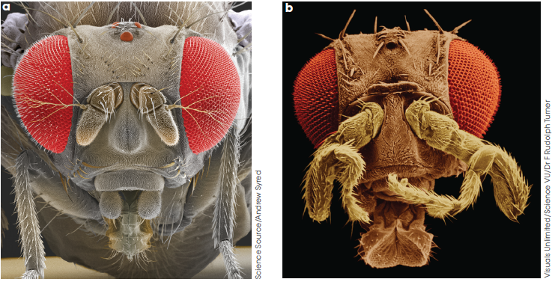
Mutant individuals provided clues about development
Development
Matching the locus of a mutation to the phenotype of the offspring can provide information about the function of the gene at that locus.
These observations have provided insights into how genes control development of organisms, such as the Drosophila fruit fly.
Figure 3.23

Slide 29
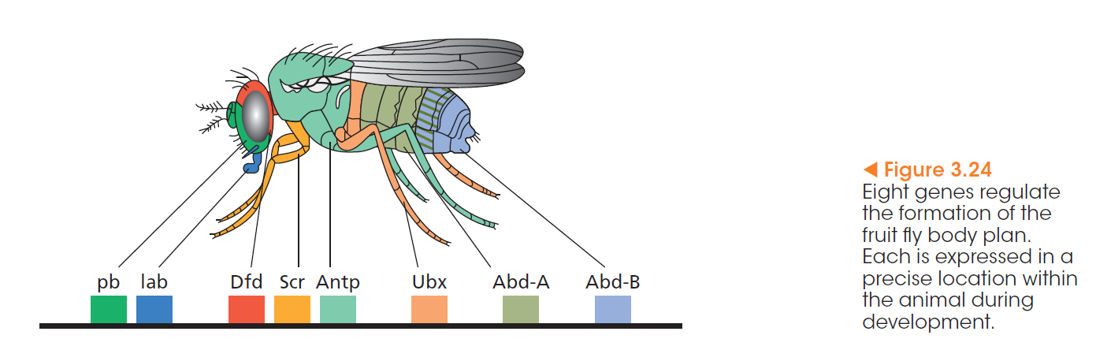
Homeobox genes
Development

Slide 30
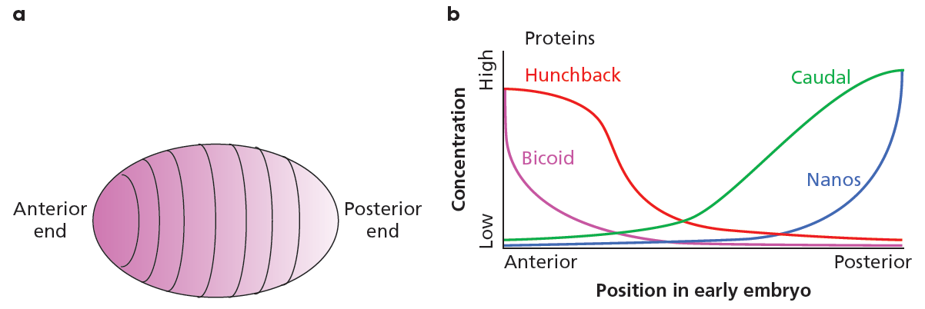
Homeobox genes
Development
Figure 3.25

Slide 31
The Y chromosome
Sex determination
The Y chromosome has genes that stimulate the male phenotype.
One of these is the SRY gene, whose protein product initiates the developmental program for the male sex.
X inactivation
Inactivation (by methylation) of one copy of the X chromosome in females avoid having too much expression of X-linked genes.

